Slide 1
Software Engineering
Noureen Fatima

Slide 2
OUTLINE -
Weeks | Topics
1 | Introduction
2 | Software Process and Process Models
3 | Agile
4 | Requirement Engineering
5 | WBS, Wideband Delphi estimation method
6 | Mid Term 1
7 | Design concepts
8 | Architectural Design
9 | UI Design
10 | Software Testing
11 | Mid Term 2
12 | Quality Management
13 | Estimation for software projects
14 | Project Scheduling and Risk management
15 | Projects and Reviews
16 | Final

Slide 3
Assessment Criteria
Evaluation | Marks Distribution
Mids | 25 Marks
Project | 10 Marks
Quizzes (best 3 out of 4) | 7.5 Marks
Assignments | 7.5 Marks
Final | 50 Marks

Slide 4
Tentative Project Deadlines
Project Proposal & Group Members’ name submission
(3rd week)
Idea approval (3rd Week)
Project, Viva and report submission
(Last week)

Slide 5
Book-wise Distribution & coverage of Chapters:
(Ian Sommerville)
Chapter 1, 2, 3, 4
Chapter 5 (System Modeling) Self study
Chapter 6 Architectural Design (Sommerville)
Chapter 8 Software Testing (Sommerville)
Chapter 24 Quality Management (Sommerville)
(Pressman)
Chapter 8 Design concepts
Chapter 11 UI Design
Chapter 26 Estimation for software projects
Chapter 27 Project Scheduling
Chapter 28 Risk management

Slide 6
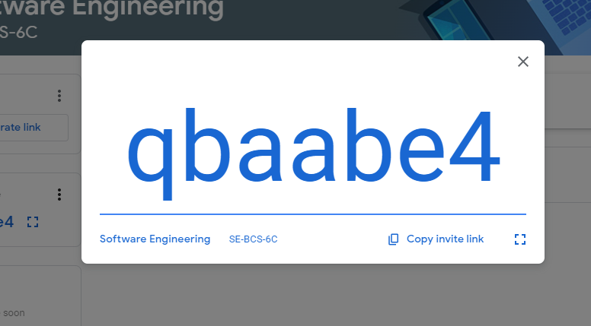
GC CODE

Slide 7
Email address and Consultation Hours :
Noureen.Fatima@nu.edu.pk
Monday ( 10:30 to 11:30 AM)

Slide 8
CHAPTER 1 - INTRODUCTION
Notes:
1.1 PROFESSIONAL SOFTWARE DEVELOPMENT
1.2 SOFTWARE ENGINEERING ETHICS
1.3 CASE STUDIES

Slide 9
Software Engineering
Software engineering has two parts:
Software is a collection of codes, documents, and triggers that does a specific job and fills a specific requirement.
Engineering is the development of products using best practices, principles, and methods

Slide 10
Formal definition :
The IEEE fully defines software engineering as:
The application of a systematic, disciplined, quantifiable approach to the development, operation, and maintenance of software; that is, the application of engineering to software.
Software engineering is concerned with theories, methods and tools for professional software development

Slide 11
Professional and ethical responsibility
Software engineering involves wider responsibilities than simply the application of technical skills
Software engineers must behave in an honest and ethically responsible way if they are to be respected as professionals
Ethical behavior is more than simply upholding the law but involves following a set f principles that are morally correct..

Slide 12
Quick Recap
About Software and Software Engineering
Difference b/w CS and SE
Software Cost
SE FAQs
Essential Attributes of a good software
Software Process Activities
General Issues that affect most of the software
Software Engineering Diversity and Application Types
Web Software Engineering

Slide 13
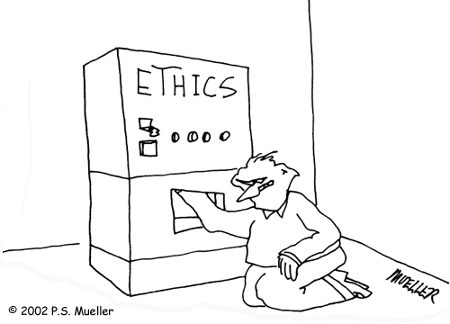

Software engineering ethics

Slide 14
Software engineering ethics
Software engineering involves wider responsibilities than simply the application of technical skills.
Software engineers must behave in an honest and ethically responsible way if they are to be respected as professionals.
Ethical behaviour is more than simply upholding the law but involves following a set of principles that are morally correct.

Slide 15
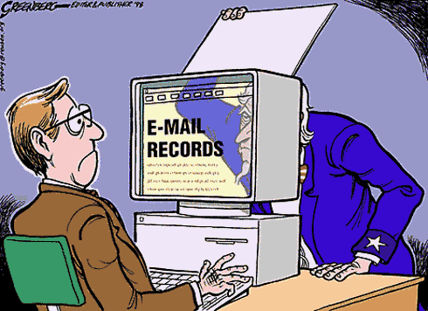
Issues of professional responsibility
Confidentiality
Engineers should normally respect the confidentiality of their employers or clients irrespective of whether or not a formal confidentiality agreement has been signed.
Competence
Engineers should not misrepresent their level of competence. They should not knowingly accept work which is outwith their competence.

Slide 16
Issues of professional responsibility
Intellectual property rights
Engineers should be aware of local laws governing the use of intellectual property such as patents, copyright, etc. They should be careful to ensure that the intellectual property of employers and clients is protected.
Computer misuse
Software engineers should not use their technical skills to misuse other people’s computers. Computer misuse ranges from relatively trivial (game playing on an employer’s machine, say) to extremely serious (dissemination of viruses).

Slide 17
ACM/IEEE Code of Ethics
The professional societies in the US have cooperated to produce a code of ethical practice.
Members of these organisations sign up to the code of practice when they join.
The Code contains eight Principles related to the behaviour of and decisions made by professional software engineers,
Practitioners
Educators
Managers,
supervisors, policy makers,
trainees and students of the profession.

Slide 18
Rationale for the code of ethics
Computers have a central and growing role in commerce, industry, government, medicine, education, entertainment and society at large.
Software engineers are those who contribute by direct participation or by teaching, to the analysis, specification, design, development, certification, maintenance and testing of software systems.
Software engineers have significant opportunities to do good or cause harm, to enable others to do good or cause harm, or to influence others to do good or cause harm.
To ensure their efforts will be used for good, software engineers must commit themselves to making software engineering a beneficial and respected profession.

Slide 19
The ACM/IEEE Code of Ethics
Software Engineering Code of Ethics and Professional Practice
ACM/IEEE-CS Joint Task Force on Software Engineering Ethics and Professional Practices
PREAMBLE
The short version of the code summarizes aspirations at a high level of the abstraction; the clauses that are included in the full version give examples and details of how these aspirations change the way we act as software engineering professionals.
In accordance with their commitment to the health, safety and welfare of the public, software engineers shall adhere to the following Eight Principles:

Slide 20
Ethical principles
1. PUBLIC - Software engineers shall act consistently with the public interest.
2. CLIENT AND EMPLOYER - Software engineers shall act in a manner that is in the best interests of their client and employer consistent with the public interest.
3. PRODUCT - Software engineers shall ensure that their products and related modifications meet the highest professional standards possible.
4. JUDGMENT - Software engineers shall maintain integrity and independence in their professional judgment.
5. MANAGEMENT - Software engineering managers and leaders shall subscribe to and promote an ethical approach to the management of software development and maintenance.
6. PROFESSION - Software engineers shall advance the integrity and reputation of the profession consistent with the public interest.
7. COLLEAGUES - Software engineers shall be fair to and supportive of their colleagues.
8. SELF - Software engineers shall participate in lifelong learning regarding the practice of their profession and shall promote an ethical approach to the practice of the profession.

Slide 21
Ethical dilemmas
Disagreement in principle with the policies of senior management.
Your employer acts in an unethical way and releases a safety-critical system without finishing the testing of the system.
Participation in the development of military weapons systems or nuclear systems.

Slide 22
Case studies

Slide 23
Case studies
A personal insulin pump
An embedded system in an insulin pump used by diabetics to maintain blood glucose control.
A mental health case patient management system
Mentcare. A system used to maintain records of people receiving care for mental health problems.
A wilderness weather station
A data collection system that collects data about weather conditions in remote areas.
iLearn: a digital learning environment
A system to support learning in schools

Slide 24
Insulin pump control system
Collects data from a blood sugar sensor and calculates the amount of insulin required to be injected.
Calculation based on the rate of change of blood sugar levels.
Sends signals to a micro-pump to deliver the correct dose of insulin.
Safety-critical system as low blood sugars can lead to brain malfunctioning, coma and death; high-blood sugar levels have long-term consequences such as eye and kidney damage.

Slide 25
Insulin pump hardware architecture

Slide 26
Activity model of the insulin pump

Slide 27
Essential high-level requirements
The system shall be available to deliver insulin when required.
The system shall perform reliably and deliver the correct amount of insulin to counteract the current level of blood sugar.
The system must therefore be designed and implemented to ensure that the system always meets these requirements.

Slide 28
Mentcare: A patient information system for mental health care
A patient information system to support mental health care is a medical information system that maintains information about patients suffering from mental health problems and the treatments that they have received.
Most mental health patients do not require dedicated hospital treatment but need to attend specialist clinics regularly where they can meet a doctor who has detailed knowledge of their problems.
To make it easier for patients to attend, these clinics are not just run in hospitals. They may also be held in local medical practices or community centres.

Slide 29
Mentcare
Mentcare is an information system that is intended for use in clinics.
It makes use of a centralized database of patient information but has also been designed to run on a PC, so that it may be accessed and used from sites that do not have secure network connectivity.
When the local systems have secure network access, they use patient information in the database but they can download and use local copies of patient records when they are disconnected.

Slide 30
Mentcare goals
To generate management information that allows health service managers to assess performance against local and government targets.
To provide medical staff with timely information to support the treatment of patients.

Slide 31
The organization of the Mentcare system

Slide 32
Key features of the Mentcare system
Individual care management
Clinicians can create records for patients, edit the information in the system, view patient history, etc. The system supports data summaries so that doctors can quickly learn about the key problems and treatments that have been prescribed.
Patient monitoring
The system monitors the records of patients that are involved in treatment and issues warnings if possible problems are detected.
Administrative reporting
The system generates monthly management reports showing the number of patients treated at each clinic, the number of patients who have entered and left the care system, number of patients sectioned, the drugs prescribed and their costs, etc.

Slide 33
Mentcare system concerns
Privacy
It is essential that patient information is confidential and is never disclosed to anyone apart from authorised medical staff and the patient themselves.
Safety
Some mental illnesses cause patients to become suicidal or a danger to other people. Wherever possible, the system should warn medical staff about potentially suicidal or dangerous patients.
The system must be available when needed otherwise safety may be compromised and it may be impossible to prescribe the correct medication to patients.

Slide 34
Wilderness weather station
The government of a country with large areas of wilderness decides to deploy several hundred weather stations in remote areas.
Weather stations collect data from a set of instruments that measure temperature and pressure, sunshine, rainfall, wind speed and wind direction.
The weather station includes a number of instruments that measure weather parameters such as the wind speed and direction, the ground and air temperatures, the barometric pressure and the rainfall over a 24-hour period. Each of these instruments is controlled by a software system that takes parameter readings periodically and manages the data collected from the instruments.

Slide 35
The weather station’s environment

Slide 36
Weather information system
The weather station system
This is responsible for collecting weather data, carrying out some initial data processing and transmitting it to the data management system.
The data management and archiving system
This system collects the data from all of the wilderness weather stations, carries out data processing and analysis and archives the data.
The station maintenance system
This system can communicate by satellite with all wilderness weather stations to monitor the health of these systems and provide reports of problems.

Slide 37
Additional software functionality
Monitor the instruments, power and communication hardware and report faults to the management system.
Manage the system power, ensuring that batteries are charged whenever the environmental conditions permit but also that generators are shut down in potentially damaging weather conditions, such as high wind.
Support dynamic reconfiguration where parts of the software are replaced with new versions and where backup instruments are switched into the system in the event of system failure.

Slide 38
iLearn: A digital learning environment
A digital learning environment is a framework in which a set of general-purpose and specially designed tools for learning may be embedded plus a set of applications that are geared to the needs of the learners using the system.
The tools included in each version of the environment are chosen by teachers and learners to suit their specific needs.
These can be general applications such as spreadsheets, learning management applications such as a Virtual Learning Environment (VLE) to manage homework submission and assessment, games and simulations.

Slide 39
Service-oriented systems
The system is a service-oriented system with all system components considered to be a replaceable service.
This allows the system to be updated incrementally as new services become available.
It also makes it possible to rapidly configure the system to create versions of the environment for different groups such as very young children who cannot read, senior students, etc.

Slide 40
iLearn services
Utility services that provide basic application-independent functionality and which may be used by other services in the system.
Application services that provide specific applications such as email, conferencing, photo sharing etc. and access to specific educational content such as scientific films or historical resources.
Configuration services that are used to adapt the environment with a specific set of application services and do define how services are shared between students, teachers and their parents.

Slide 41
iLearn service integration
Integrated services are services which offer an API (application programming interface) and which can be accessed by other services through that API. Direct service-to-service communication is therefore possible.
Independent services are services which are simply accessed through a browser interface and which operate independently of other services. Information can only be shared with other services through explicit user actions such as copy and paste; re-authentication may be required for each independent service.

Slide 42
iLearn architecture

Slide 43
Open Book Quiz
For each of the clauses in the ACM/IEEE code of ethics discussed in class, suggest an appropriate example that illustrates that clause.

Slide 44
Key points
Software engineering is an engineering discipline that is concerned with all aspects of software production.
Essential software product attributes are maintainability, dependability and security, efficiency and acceptability.
The high-level activities of specification, development, validation and evolution are part of all software processes.
The fundamental notions of software engineering are universally applicable to all types of system development.

Slide 45
Key points
There are many different types of system and each requires appropriate software engineering tools and techniques for their development.
The fundamental ideas of software engineering are applicable to all types of software system.
Software engineers have responsibilities to the engineering profession and society. They should not simply be concerned with technical issues.
Professional societies publish codes of conduct which set out the standards of behaviour expected of their members.

